Slide 1
Speeding up transposition-invariant string matching
Sebastian Deorowicz
Information Processing Letters, In Press, Corrected Proof, Available online 12 June 2006
Presenter： Shiuan-Wen Chen
Date： Ju1. 19, 2006

Slide 2
Abstract
Finding the longest common subsequence (LCS) of two given sequences A = a₀a₁ . . . a_{m−1} and B = b₀b₁ . . . b_{n−1} is an important and well studied problem. We consider its generalization, transposition-invariant LCS (LCTS), which has recently arisen in the field of music information retrieval. In LCTS, we look for the LCS between the sequences A +t = (a₀ +t)(a₁ +t) . . . (a_{m−1} +t) and B where t is any integer. We introduce a family of algorithms (motivated by the Hunt–Szymanski scheme for LCS), improving the currently best known complexity from O(mnloglogσ) to O(D loglogσ + mn), where σ is the alphabet size and D ≦ mn is the total number of dominant matches for all transpositions. Then, we demonstrate experimentally that some of our algorithms outperform the best ones from literature.

Slide 3
1. Introduction
Recently it was also used in music information retrieval(MIR) for melodies stored in MIDI format, which are described by pitch values and durations.
Therefore, a transposition-invariant version of LCS, called LCTS, for the pitch values is more appropriate [3,9,10].
The LCTS finds applications also in time series comparison, image comparison, and other areas [14].

Slide 4
2. Definitions and problem statement
The sequences A = a₀a₁ . . . a_{m−1} and B = b₀b₁ . . .b_{n−1} are over Σ, Σ = {0, . . . , σ }.
A transposed copy of the sequence A, denoted as A + t, for some t ∈ Z is (a₀+t)(a₁+t) . . . (a_{m−1}+t).
ex: A=23561, A+1=34672
The longest common transposition-invariant subsequence (LCTS) of A and B is the longest common subsequence of B and A+t for any t ∈ [−σ, σ].

Slide 5
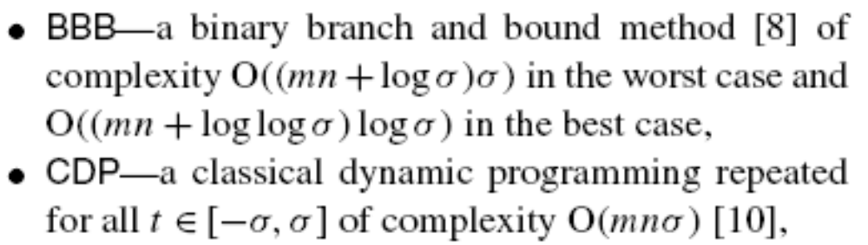
3. Background and related work
The easiest way to calculate the LCTS is to run any classical LCS algorithm for all possible values of t.
There are also algorithms specialized for LCTS.
Currently, best worst-case complexity for LCTS is O(mnlog logσ) [14].
we introduce a family of algorithms and compare them to:

Slide 6
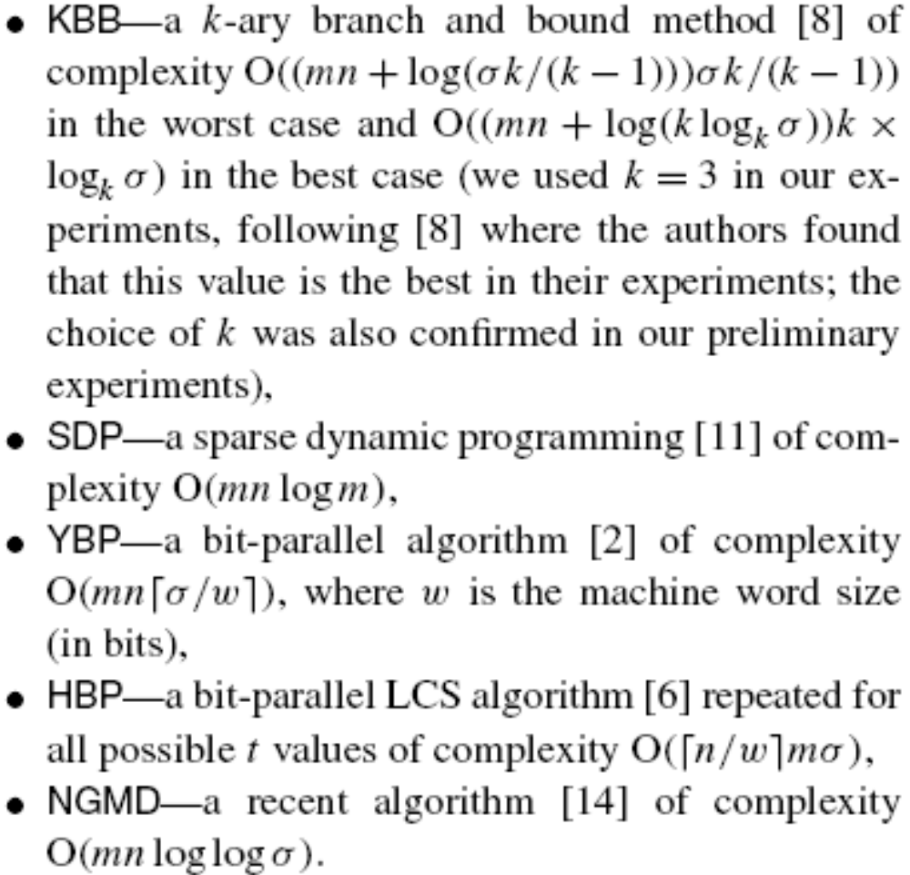
3. Background and related work

Slide 7
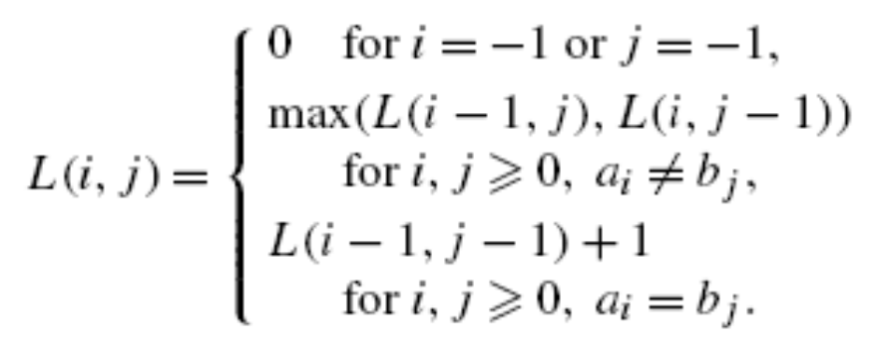
3. Background and related work
If (i, j ) is a match and the LCS length for A_{i} and B_{j} is k, then k is the rank of (i, j ).
The match (i, j ) is k-dominant if it has rank k and there is no other match (i, j) of rank k such that i ’ ≦ i and j ’≦ j .
The classical algorithm for the LCS employs dynamic programming:

Slide 8
4. Our approach
The idea of our method is to compute the LCS for all the transpositions using the sparsity of the LCS problem.
For each match(i, j ) we compute its rank. To do this, we need to know the value of L(i − 1, j − 1). It is obvious that it is the highest rank of all such matches (i ’, j ’) that 0 ≦ i ’< i and 0 ≦ j ’< j.
we maintain a data structure E storing the triples <row_idx, col_idx, rank> for such matches.
Notice that these are dominant matches and ranks in E grow by 1, since any k-dominant match must be preceded by some (k −1)-dominant match.

Slide 9
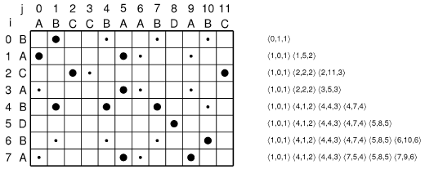
4. Our approach
Fig. 1. Example of the algorithm in work. The left side shows the matrix with marked matches, while the right side presents the contents of the E
data structure after processing each row.

Slide 10
4. Our approach
Now we assume that we know the r matches and for each match (i, j ) we do a few operations. At most once we: look for the entry with column index j , look for the match with lowest column index greater than j , remove a match, insert a match.
Since the matches in E are ordered by column index, which is from the range [0,n − 1], we can also use a van Emde Boas tree [15,16], which offers the complexity O(log log v) of necessary operations, where v is the range of the stored values, so in our case it would lead to the total complexity O(r log log n).

Slide 11
4. Our approach
We use a family of ┌n/e┐ van Emde Boas trees, each of size e ≦n covering the possible column indexes range [0,n − 1], i.e., the 0th tree stores values from [0, e−1], the 1st tree stores values from [e, 2e−1], and so on.
When we insert, remove, or look for the column index j we use the └j/e┘th tree and each of these operations consumes O(log log e) time.
The time to find the successor in a tree is O(log log e), and the additional time of unsuccessful searches is O(n/e) per row. The total complexity for such a data structure is O(r log log e +mn/e).

Slide 12
4. Our approach
We can, however, accompany each van Emde Boas tree with a bit vector of size e, telling which values are stored in the tree.
Let us notice that the most frequent operation on E, executed once for at most all the matches, is to check whether the column index of the match is in E. The other operations for a match are only executed if the match is dominant.
This way we can improve the time complexity of the algorithm to O(d log log e + r + mn/e), where d is the number of dominant matches.

Slide 13
4. Our approach
Now we switch to the LCTS problem.
The first one is to solve the LCS(A + t,B) for all t ∈ [−σ, σ]. In this case, we run the described algorithmΘ(σ) times and the total number of matches is mn.
Therefore, we obtain an algorithm for the LCTS problem of complexity O(D log log e +mn+mnσ/e), where D is the total number of dominant matches for all the transpositions, which is obviously minimized for e = Θ(σ), yielding the total complexity of O(D log log σ +mn).

Slide 14
4. Our approach
We can create a list for each alphabet symbol storing the positions of its appearance in B in time O(n +σ) for the whole LCTS algorithm.
Then, each time we move through the matrix rows we always have the positions of the matches ready.
Because we traverse the matrix for each possible value of t, we need the additional time O(mσ) for visiting the rows to check whether there are some matches in them or not.
When σ = O(n), the complexity obtained in the above paragraph is true, but otherwise we should write it as O(D log logσ + m(n +σ)).

Slide 15
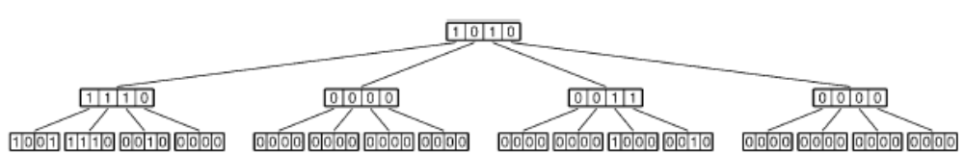
4. Our approach
Since van Emde Boas trees are slow in practice, we propose to replace them with some other data structures.
Convenient candidates are w-ary trees, where w is the machine word size (in bits).
Fig. 3. Sample tree of arity 4 storing integers from the range [0, 63] (the integers 0, 3, 4, 5, 6, 10, 40, 46 are stored in leaves).

Slide 16
4. Our approach
Each inner node stores up to w bits; a bit is set iff the corresponding child node is non-empty. Data are stored in leaves; a bit is set iff the integer is in the tree
To check whether x is in the tree it suffices to check the (x mod w)th bit in the └x/w┘th leaf.
All these operations need O(log v/ logw) time, where v is the range of stored values. Setting v = Θ(σ) leads to the O(D ┌logσ/logw┐ +mn) and O(D ┌logσ/logw┐ + m(n +σ)) algorithms.

Slide 17
4. Our approach
Another option is to set e = w and organize E as an array of ┌n/w┐ unsigned integers. To check whether a column index j is present in E, it suffices to check the (j mod w)th bit in the └j/w┘th integer, which needs O(1) time.
Finding the successor of (j mod w) in the └j/w┘th integer, also can be done in a constant time, but there is an additional cost of unsuccessful findings of successors of O(┌n/w┐) per row, O(m┌n/w┐) per transposition.
This leads to O(mn + mσ┌n/w┐) algorithms.

Slide 18
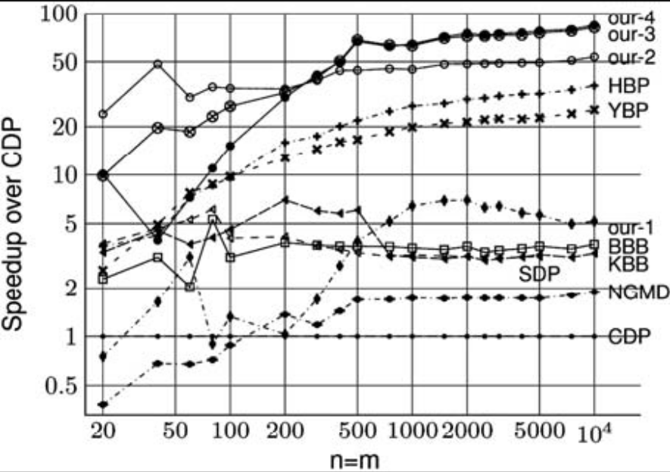
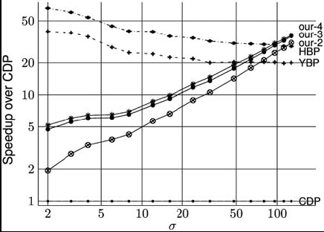
5. Comparison of algorithms for LCTS
The running times are median values of
501 executions for different pairs of sequences.

